Slide 1
Training of Postgraduate Instructors on Technology Enhanced Teaching and Supervision
Zoom Video Conferencing
Platform
17th June, 2020

Slide 2
Outline
What is Zoom Video/Audo Conferencing?
How to install Zoom
How to Join a Zoom meeting
How to participate in a Zoom meeting
How to schedule and manage Zoom meeting
Notes:
Completion Rate is 11%

Slide 3
What is Zoom?
Is a web conferencing platform
Commonly used for audio and/or video conferencing.
Designed for one-on-one or group calls
Can be used on desktop/laptop/mobile devices
Notes:
Completion Rate is 11%

Slide 4
How to install Zoom
Go to https://zoom.us/download
From the Download Center, click on the Download button under “Zoom Client For Meetings”.
Notes:
Completion Rate is 11%

Slide 5
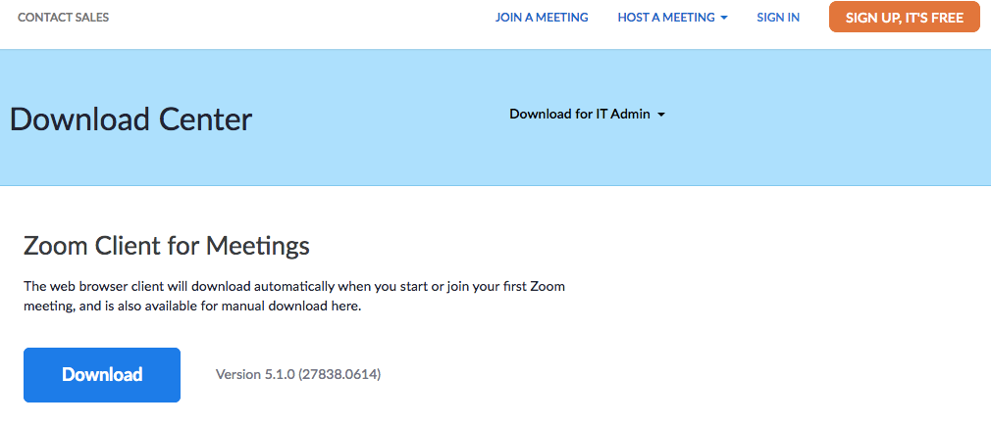
Notes:
Completion Rate is 11%

Slide 6
How to install Zoom
You can install the Zoom Client for Meeting application
You can sign-up (i.e. create a free account
Notes:
Completion Rate is 11%

Slide 7
How to install Zoom
For Zoom Client run the downloaded file
A Zoom icon will be added to your applications
Notes:
Completion Rate is 11%

Slide 8
How to install Zoom
You can also sign-up for free Zoom Account
With the Zoom account you will be able to schedule meetings
Notes:
Completion Rate is 11%

Slide 9
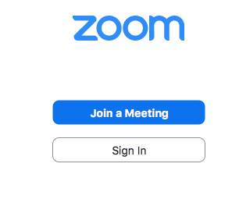
How to join Zoom meeting
Run the Zoom Client Application by clicking on the Zoom icon
Click on Join a Meeting
Notes:
Completion Rate is 11%

Slide 10
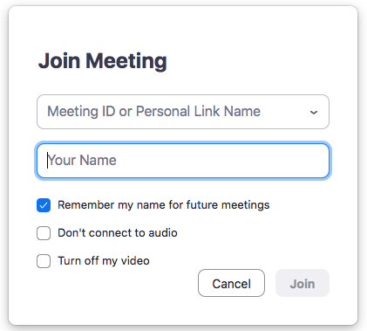
You need Meeting ID
Meeting Password
Registration
Turn off my video
Notes:
Completion Rate is 11%

Slide 11
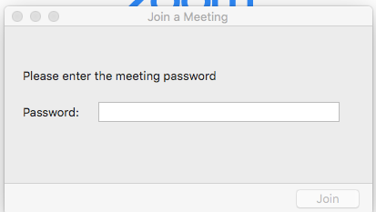
Notes:
Completion Rate is 11%

Slide 12
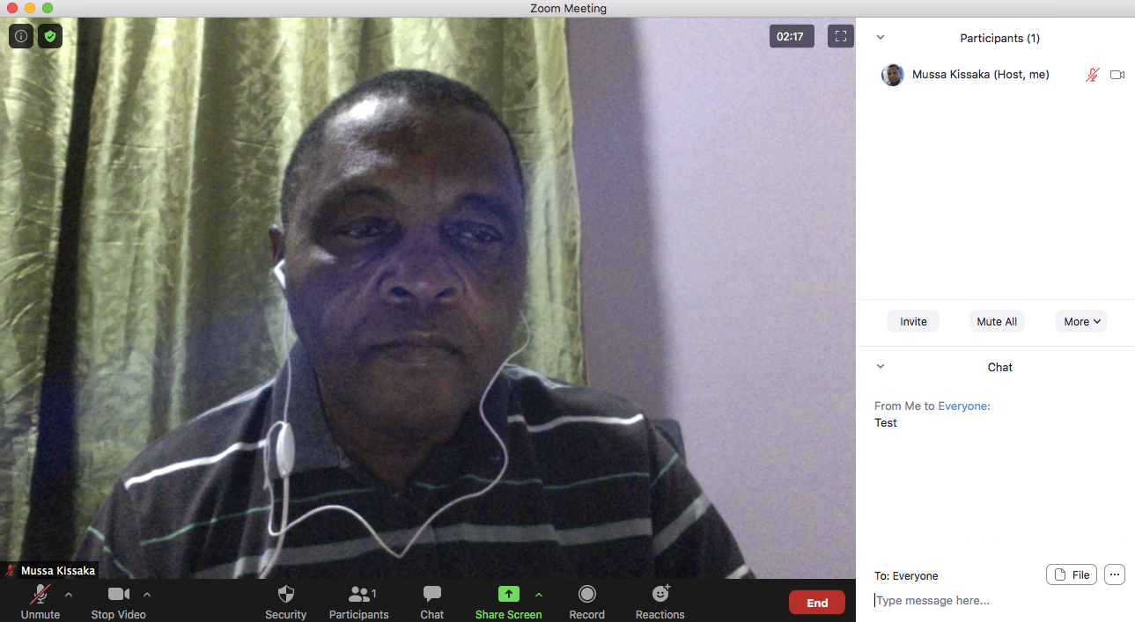
Notes:
Completion Rate is 11%

